Slide 1
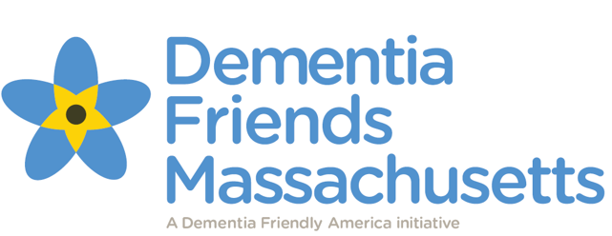
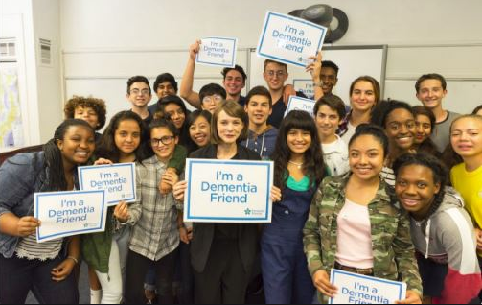
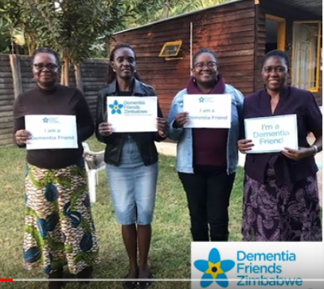
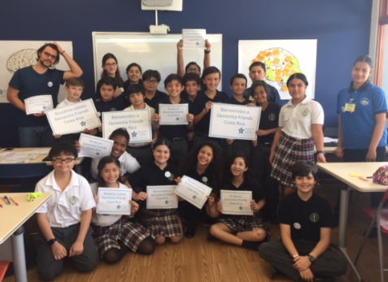
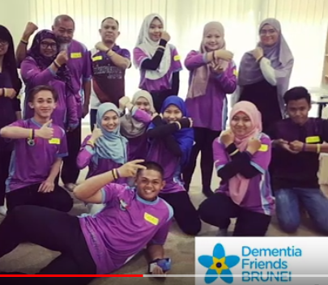
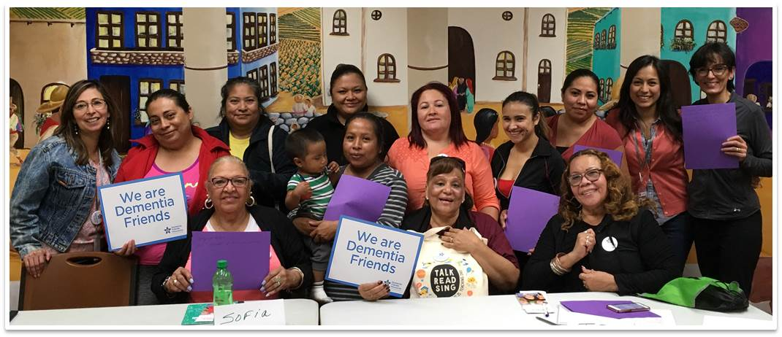
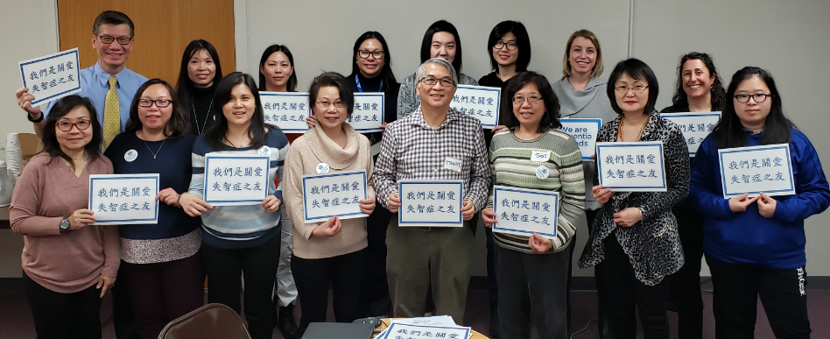
Welcome!
Dementia Friends is a global movement that was developed by the Alzheimer’s Society in the United Kingdom, with origins in Japan’s Dementia Supporter program. It is now underway in the United States.

Slide 2
The goal is to help everyone in a community understand five key messages about dementia, how it affects people, and how we each can make a difference in the lives of people living with the disease.
People with dementia need to be understood and supported in their communities. Dementia also has a huge impact on family members and friends, and they need support and understanding, too. You can help by becoming a Dementia Friend. Thank you for being here!

Slide 3
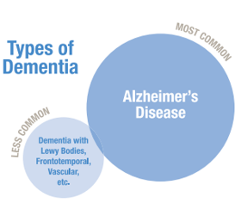
Dementia: What You Should Know
Dementia is not a specific disease. It's an umbrella term that covers many symptoms. These include memory loss and changes in other thinking skills, severe enough that a person has a hard time doing everyday activities. Alzheimer's disease is the most common type of dementia and accounts for 60 to 80 percent of cases. Other types of dementia include Dementia with Lewy Bodies, Frontotemporal, and Vascular. In general, dementia gets worse over time.

Slide 4
Normal Aging vs. Alzheimer’s Disease
It’s normal for a person’s memory to change as they grow older. We may sometimes forget names or appointments, but then remember them later. Vision may change, also; we might need reading glasses or develop cataracts. As we get older, we may develop specific routines for doing things, and feel frustrated when these routines are interrupted. These changes are typical with aging. Dementia is different.

Slide 5
These are the 10 early signs and symptoms of dementia:
1. Memory loss that disrupts daily life.
2. Challenges in planning or solving problems.
3. Difficulty completing familiar tasks at home, at work or at
leisure.
4. Confusion with time or place.
5. Trouble understanding visual images and spatial
relationships.
6. New problems with words in speaking or writing.
7. Misplacing things and losing the ability to retrace steps.
8. Decreased or poor judgment.
9. Withdrawal from work or social activities.
10. Changes in mood and personality
Source: 10 Early Signs and Symptoms of Alzheimer’s
www.alz.org/10-signs-symptoms-alzheimers-dementia.asp

Slide 6
Five Key Messages Video
https://www.youtube.com/watch?v=4oIrRTayLJw

Slide 7
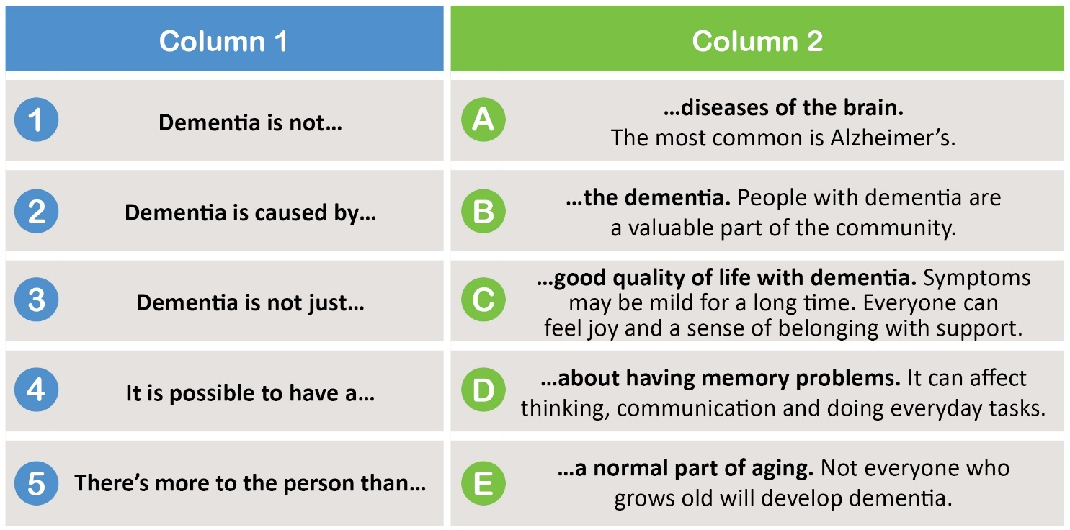
Broken Sentences Worksheet
Match the sentences in Column 1 to Column 2 by drawing a line from each sentence start to the corresponding sentence end. You should end up with five sentences that make sense.

Slide 8
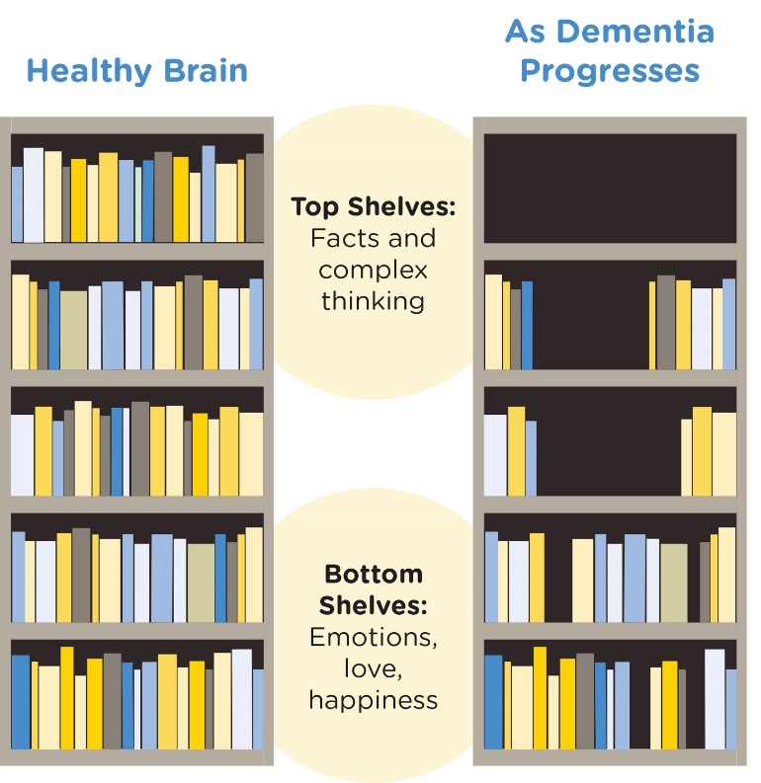
Bookcase Story
Imagine that each of us has a bookcase, that we’ve been filling up throughout our lives. Each book inside the bookcase represents one of our skills or memories.
On the top shelves are our memories of facts and our skills for thinking in complicated ways. This includes skills like counting money, using language, planning our activities and making sure that our behavior fits the situation. Dementia usually damages the top or outer part of the brain first. In our story, this means that it removes the books on these top shelves.

Slide 9
Everyday Tasks

Slide 10
Communication
Consider these tips when communicating with a person who is living with dementia.
Treat the person with dignity and respect. Avoid talking past the person as if he or she isn’t there. Include the person in the conversation.
Be aware of your feelings. Your tone of voice may communicate your attitude. Use positive, friendly facial expressions.
Be patient and supportive. Let the person know that you are listening, that you care about what they’re saying, and you want to understand. Be careful not to interrupt.

Slide 11
Offer comfort and reassurance. If the person is having trouble communicating, reassure them that it’s okay and encourage them to continue.
Avoid criticizing or correcting. Don’t tell the person that what they are saying is incorrect. Instead, listen and try to find the meaning in what is being said. “Focus on the feelings, not the facts.”
Sometimes it’s easier not to use words. If you don’t understand what the person is saying, ask them to point or gesture. When spending time together, listening to music together, or a gentle hug can sometimes work better than talking.
Know that an individual’s communication patterns may change. In general, dementia changes a person’s brain more and more over time. Communication tips that work now may not work as time goes by, and you may have to try a new approach.

Slide 12
Conversation Tips
When approaching a person who is living with dementia and starting a conversation:
Come from the front, identify yourself, and keep good eye contact. If the person is seated or reclined, sit down so that you’re at eye level.
Use short, simple phrases and repeat them if needed. Ask one question at a time.
Speak slowly and clearly. Use a gentle and relaxed tone.
Patiently wait for a response. Give the person time to process what you said.

Slide 13
Five Key Messages
Dementia is not a normal part of aging. Not everyone who grows old will develop dementia.
Dementia is caused by diseases of the brain. The most common is Alzheimer’s.
Dementia is not just about having memory problems. It can affect thinking, communication and doing everyday tasks.
It is possible to have a good quality of life with dementia. Symptoms may be mild for a long time. Everyone can feel joy, comfort and a sense of belonging with support.
There’s more to the person than the dementia. People with dementia are a valuable part of the community.

Slide 14
Turn Your Understanding into Action
Please tell us how you are going to turn your understanding of dementia and what it means to be a Dementia Friend into a practical action. Every action counts.

Slide 15
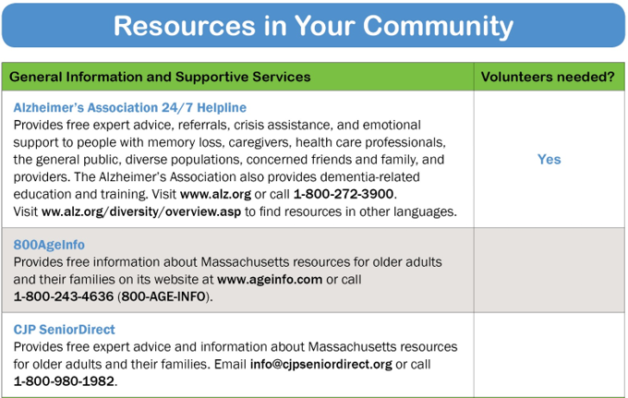
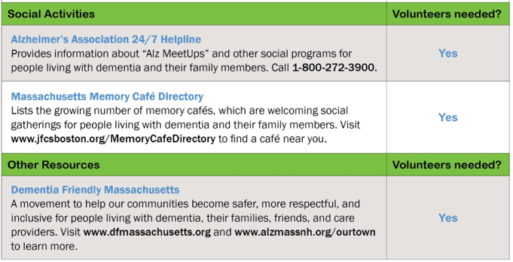
To learn about becoming a Dementia Friends Champion so that you can deliver these information sessions in your community, please visit www.dementiafriendsma.org or contact Beth Soltzberg at bsoltzberg@jfcsboston.org

Slide 16
Martha’s Vineyard Center for Living – Services*
Supportive Day Program Mon-Fri 9-2pm
*a daily activity program for individuals at risk at home
*exercise
*conversation /socialization
*projects
*games/lectures
*lunch and community
Open House Fridays 10-11 Music & Memory Café*
Dementia Family Support Services
*memory screenings
*Dementia Coaching or Habilitation services
*support, counselling and referral
*Weekly Caregiver Support Group
Call 508-939-9440
mvcenter4living.org *Fully vaccinated & Masked

