Slide 1
i2 Public Health Excellence C O L L A B O R A T I V E

Slide 2
Island Integrated Public Health Collaborative (i2) Background
No official regional public health department
No systematic community needs assessment or routine public health data collection/analysis to inform health service delivery/response
Growing need to assess public health data on Social Determinants of Health (SDoH), including health equity
Growing municipal, state and federal budget support for health/social/environmental services without a strategic plan for integration, monitoring and measuring outcomes (ROI, accountability for tax dollars)
2019 County/Select Board unanimous support to provide space above MVC4L to launch proposed collaborative – and then came the pandemic, putting early implementation plans on pause
IHC health center, MV Boards of Health and MV Hospital partnership solidly forged through highly successful two-year community-wide COVID response
Ongoing and increasing need for integrated workforce development and training

Slide 3
Charge from the Commonwealth’s State Action for Public Health Excellence (SAPHE) Blueprint for Public Health Excellence Report
“Increase cross-jurisdictional sharing of public health services to strengthen the service delivery capacities of local public health departments.”
In FY 2022, six Vineyard Boards of Health and Nantucket Health Department received a multi-year state SAPHE grant funding and chose Island Health Care as the organizational home for their 3 new shared employees: Public Health Biologist, Public Health Inspector and Community/Population Health Specialist.

Slide 4
Our Vision
Excellence | Resilience | Equity | Sustainability
in
Health | Housing | Food Safety and Security | Climate and Environment
_____________________________

Slide 5
Our Work – and Work Groups
Ongoing Needs Assessment
Public Outreach and Engagement
Strategic Plan and Response
Workforce Development and Training
Performance Measurement
Integrated Public Health Services

Slide 6
Our Team
Project Director/Chief Public Health Officer
Public Health Excellence Grant Facilitator
Community/Population Health Specialist
Public Health Biologist
Public Health Inspector
Public Health Nurses (2)
Board of Health Agents (6)
Island Health Care Community Health Workers (7)
Senior Management Island Health Care Community Health Center (6)

Slide 7
Partners – Actual and Proposed (partial listing)
Island Boards of Health Island Select Boards
Martha’s Vineyard Vision Fellowship Dukes County Commission
Island Health Care FQHC MA Association of Boards of Health
Town of Nantucket Dukes County Health Council
Island Grown Initiative Island Law Enforcement and Public Safety
Community Ambassador Partnership Martha’s Vineyard Commission
Island Housing Trust Island Climate Action Network
Coalition to Create MV Housing Bank NAACP
MA League of Community Health Centers Martha’s Vineyard and Nantucket Hospitals
Vineyard Wind/Vineyard Power Vineyard Health Care Access Program
Wampanoag Tribe of Gay Head (Aquinnah) MV Community Services/Island Counseling

Slide 8
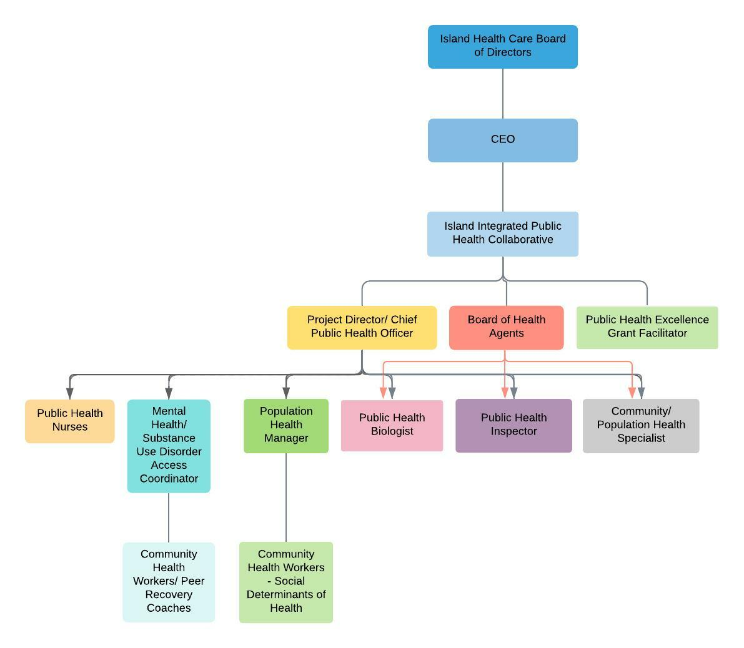
Draft Organizational Chart

