Slide 1
MV and Gosnold Climate Action Plan
Martha’s Vineyard Commission and lead town Oak Bluffs
2021 - 2022
MA Municipal Vulnerability Preparedness (MVP) Program Action Grant

Slide 2
Community Resilience Workshops
All 7 Dukes County towns held
workshops; participants identified town climate resilience priorities.
Participation made all towns eligible for MVP Action Grants
Steps to the Climate Action Plan (CAP)
MA Municipal Vulnerability Preparedness Program (MVP)
2017 - 2018

Slide 3
Add more
,
NAACP
Climate Action Plan, Phase I (completed)
MVP Action Grant
2019 - 2020
Collation of over 400 local, regional and state documents
Town-by-town Climate Adaptation Booklets presented to each Island Select Board
Community Listening Sessions
Listening Sessions
Realtors
NAACP
Harbor Masters
Planning Boards
Building Inspectors
Climate Committees
Emergency Managers
Town Administrators
Highway Superintendents
Farmers/Shell fisherman
Chamber of Commerce
Pond Associations
Conservation Groups
Seniors
Wampanoag Tribe of Gay Head (Aquinnah)
Conservation Commissions
Oak Bluffs Association

Slide 4
Martha’s Vineyard Commission
2019
Climate Action Task Force
and
CAP Grant Phase I
Energy Working Group
Roadmap to 100% Renewable Energy MV
Climate Resilience Committee
Climate Action Plan
MV and Gosnold Climate Action Plan
MVP Action Grant 2020-2021
Facilitation Team
Steering Committee
Includes reps from town climate/energy committees, Wampanoag Tribe of Gay Head (Aquinnah), NAACP, Brazilian community
Thematic Working Groups
(Includes Gosnold Group, students reps)
Specialty Consults
Implementation : MVC, towns, conservation, health and safety, food security,
business, energy , groups, state agencies, community members

Slide 5
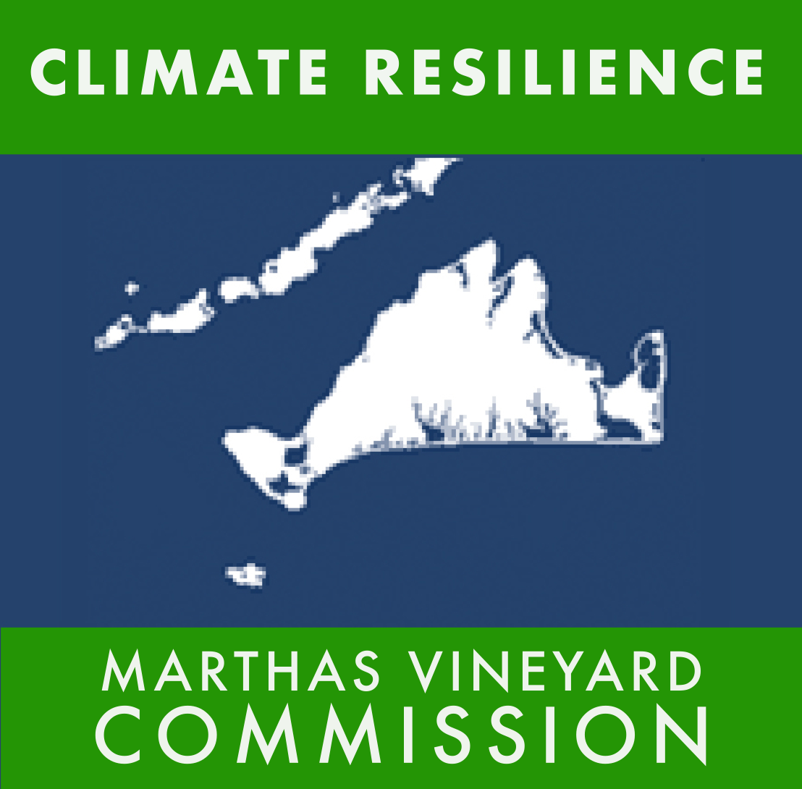
MV & Gosnold Climate Action Plan, Phase II
A regional, locally driven, 20-year CAP
for the seven towns of Dukes County
Identify long-term goals, priority actions, and implementation steps to build our social, environmental and economic resilience to the impacts of climate change and to minimize our contributions to its causes.
Land use and natural resources
Infrastructure and transportation
Public health and safety
Food security
Economic resilience
Energy transformation

Slide 6
Six Thematic Areas/Working Groups
Land Use, Natural Resources, and Biodiversity
Public Health and Safety - Lila Fischer, liaison
Transportation and Infrastructure
Food Security
Economic Resilience
Energy Transformation

Slide 7
CAP Guiding Values
Healthy Natural Resources
Equity and Inclusion
Community Collaboration
Resilience
Local Action

Slide 8
Public Health and Safety
Thematic Working Group Focus
Public Health
Protect and improve public health and well-being
of people due to climate change impacts
Public Safety
Protect and safeguard the community before, during, and after extreme weather events

Slide 9
Public Health and Safety
Main Local Climate Change Impacts to Public Health
Increased heat related illness (e.g., heat stroke, cardiovascular disease) with higher temperatures placing stress on people working and recreating outdoors. Heat stress on vulnerable populations such as the elderly and those without air conditioning
Increased respiratory illness such as pollen, mold and wildfire smoke, increase with higher temperatures, as heat/rain events become more extreme
Increased mental illness including stress and anxiety from extreme events that cause injury, loss of property/security, displacement, or death
Increased vector-borne disease due to increased tick and mosquito populations with increased air temperatures, drought, extreme rain

Slide 10
This group will focus on
Public health: protect and improve public health and welfare of people due to climate impacts
Public safety: protect and safeguard community before, during and after extreme weather events
Public Health and Safety
Main Local Climate Change Impacts to Public Safety
Lack of freshwater access - for resents dependent on well water (power outages)
Lack of transportation and supplies on/off Island with SSA disruptions (Supply chain)
Lack of access due to damage to infrastructure and flooded areas
Challenges with Emergency Response
Damage and flooded areas
High population of remote and isolated residents, especially elderly
Public Health and Safety
Main Local Climate Change Impacts to Public Safety
Emergency response challenges
Remote and isolated residents
Lack of access due to damaged infrastructure and flooded areas
Lack of freshwater access (for those dependent on well water)
Lack of transportation and supplies (supply chain)
Increased power outages
Decreased pond water quality
Extreme weather damage to people, businesses, infrastructure, post disaster impacts
Impacts to fresh water quality

Slide 11
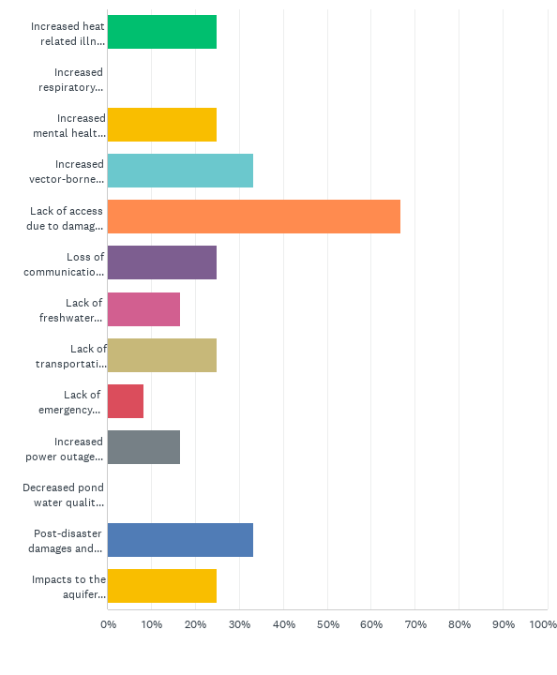
Survey Results
Q2: In your opinion, what are the three biggest challenges to our public health and safety from climate change that we should address in this process? (Please note: this question requires that no more or less than three boxes be checked.) 12 TOTAL RESPONSE
Increased heat related illness (e.g., heat stroke, cardiovascular disease) with higher temperatures placing stress on people working and recreating outdoors. Heat stress on vulnerable populations such as elderly and those living without air conditioning
Increased respiratory illness as pollen, mold, and wildfire smoke, increase with higher air temperatures, and heat/rain events become more extreme
Increase mental health issues including stress and anxiety from extreme events that cause injury, loss of property/security, displacement, or death
Increased vector-borne disease due to increased tick and mosquito populations (e.g., alpha-gal, lyme, dengue) with increased air temperatures, drought, and extreme rain
Lack of access due to damage to infrastructure and flooded areas (including the hospital) during storm events with sea level rise and storm surge, and inland flooding from extreme rainfall events.
High population of remote and isolated residents, especially elderly.
Loss of communications during extreme weather events
Lack of freshwater access: for much of the island dependent on well water during storm events and power outages
Lack of transportation and supplies on/off island with SSA disruptions
Lack of emergency medical evacuations
Challenge with communicating need for preparedness/action to parts of the public who don’t believe in climate change
Increased Power Outages - due to extreme weather events impacting people with home medical devices
Decreased pond water quality with increased runoff and high temperatures leading to more food borne illness and other conditions
Post-disaster damages and community disruption due to extreme weather events.
Impacts to the aquifer quality/quantity - potential contamination with increased storm and extreme rain events

Slide 12
Imagine it's 2040: Briefly describe what has been accomplished at a regional scale that makes our public health and safety resilient to the impacts of climate change?
Coordinated Emergency Preparedness
An established and stress tested public safety/health/disaster communication plan that can perform without internet, electricity, or cell capability / is adaptable for non-technical audiences, elderly, and groups that speak other languages
emergency preparedness for storms that have curtailed road travel in place, including some infrastructure change.
Established response teams developed to address emergency evacuation coordinated with Coast Guard, Steamship Authority etc.
Island Wide Disaster Coordination, all communities, one central office of Communication.
Each of the town has designated emergency shelters with heating, cooling, kitchens, and designated personnel.
MV, Nantucket, and Gosnold have regionalized their public health effort and share resources related to reporting, inspection, epidemiology surveillance, and data collection
Central Centers established to provide safe housing if a natural disaster occurs in each community.
Improvements to long-term year-round housing availability for health and related professionals so we can have first responders in place when an extreme event hits the island
More resilient electric grid to keep power on during extreme weather

Slide 13
Community Health & Resilience through Community Engagement/Awareness/Education
Cert team in each town with knowledge of each resident's health needs
increased public awareness about limited evacuation on island and increase in home preparedness for medical emergencies (CERT teams, etc.)
Create CERT teams in each town
Every town has a CERT team in place, and neighborhood watch groups have been set up all over the island, so neighbors can help those who need it.
Building, support and training of local population to become more self sustaining and resilient. Training of CERT teams, increase volunteerism, in either emergency, social or food organizations.
Wide spread community education about climate change adaptation, resilience and mitigation and reversing environmental degradation
Increase local awareness and participation in sustainable housing, affordable housing, landscape development and support community and local businesses.
increased awareness about the connection of tick born illness and climate, understanding about tick bite prevention
Island wide effort to reduce tick populations on island and significant reduction in vector borne diseases as a result

Slide 14
Equal Access to Health Services, Food and Clean Water
Erase inequality disparities that could cause some minorities to be affected more by the climate change this community will experience.
Make accessible healthcare through free clinics so all people including minorities and those without health insurance can receive treatment for issues caused by environmental changes
Increased support for mental and local health. Find both professional help and financing to keep local community supported in local and mental health.
Make sure clean water is an option for all and that some aren't suffering because of contaminated aquifers while others can afford things like their own filtration systems.
Secure safe drinking water (aquifer protection) and local food sources that keep our communities thriving
Protect aquifer
Public access to power and clean water during storms and power outages
Housing shelter for all

Slide 15
Others – (Most will go to other groups like transportation & infrastructure OR Land Use)
Flooding has been decreased due to berms and re-routing of water flow in flood zones, thus increasing access to the hospital and emergency shelters.
improvements to roads that are often flooded
Unified Island response to climate change prevention & mitigation, including decision on rebuilding in flood plains, building codes, & tourism.
All overhead power lines, cables now underground. Reduced risk of power & communication outages.
Improvements to the accessibility of transportation on and off island
Island is now self-sustaining as to food, power, & diverse economy.

Slide 16
CAP Definition of Goal:
A broad statement on what we are trying to achieve overall. They should be long term (15-20 years), describe the ultimate result of our efforts, and be easy to understand.
Next:
Strategies
SMART Objectives
Actions and Implementation
Measures of Success/Success

Slide 17
Public Health and Safety Goals - January 19, 2022
Coordinated Emergency Response
By 2040, in order to provide for the safety of all residents and visitors, we have effective county-wide emergency preparedness, response, and recovery, including multilingual communication and adequately equipped shelters.
Community Health and Resilience through Engagement/Awareness/Education
By 2040 we have raised awareness of the threats posed by climate change and implemented locally-initiated programs to foster environmental and community health, wellness and resilience.
Equal Access to Health Services, Food and Clean Water
By 2040, as we face the challenges of climate change, we will recognize the relationship between environmental and human health and have equitable aid and opportunity for health and well being with specific attention to the most vulnerable in the community.

Slide 18
Interconnectedness of CAP Themes
Public Health and Safety
Transportation and Infrastructure: safe roads and infrastructure, stable supply chain, hospital access
Land Use, Natural Resources and Biodiversity: healthy land and water
Food Security: more healthy, local food, food security for vulnerable population
Economic Resilience: healthy work force, safe, climate-resilient Island
Energy Transformation: improved air quality, fewer power outages

Slide 19
Mmm
December 2021 - Public Health and Safety
CAP Monthly Community Outreach
Monthly Thematic Events leading up to Climate Week
January - Land Use, Natural Resources, and Biodiversity
February - Transportation and Infrastructure
March - Economic Resilience
April - Energy Transformation
January 20
Wampanoag Tribe of Gay Head (Aquinnah) - Tribal Climate Action Planning
January 27
Vineyard Conservation Society - Land Use and Climate Change
Zoom links at www.islandclimateaction.org
Island Climate Action Network website
Climate Cafes

Slide 20
Climate Week
May 8 - 14, 2022
Climate Action Week
May 8 - 14, 2022
Raise Awareness of:
Island climate issues
What is being done to address climate impacts
What everyone can do to make a difference
Weeklong, Island-wide events and activities to encourage individual
and community-wide climate change resilience action
Climate Action Week finale event
at the Grange,
Saturday, May 14
Contact durkee@mvcommission.org

Slide 21
Climate Action Fund
Established by MV Community Foundation
for projects that will:
Provide local matches for grant projects
Implement town, tribal, county, and MVC climate change resilience projects
MVCF
P.O. Box 243
West Tisbury, MA 02572
“Climate Action Fund’
or online at
www.marthasvineyardcf.org

Slide 22
Climate Resilience: turning challenges into opportunities
MVP Action Grant Application, May 2021
MV & Gosnold Climate Action Plan, Phase II - 2021-2022
for
“Stop burning fossil fuels
and move to higher ground.”
Jeff Goodell
Author, The Water Will Come
Liz Durkee
MVC Climate Change Planner
durkee@mvcommission.org

