Slide 1
Notes:
Plan is based on MPH student work over tAutumn of 2021
Every one has had the opportubity to contribute and review
Overwhelmingly have established direction and
Move to accept plan

Slide 2
Results of MarCom survey is driving future action for the Council
Members believe:
Need a community presence
Should have a marketing methodology
Need for budget for acquisition of resources
Enlisting and featuring member expertise is reasonable and acceptable
Sponsorships and endorsements are an important activity for the Council

Slide 3
Call to accept the MarCom plan Mary Jane

Slide 4
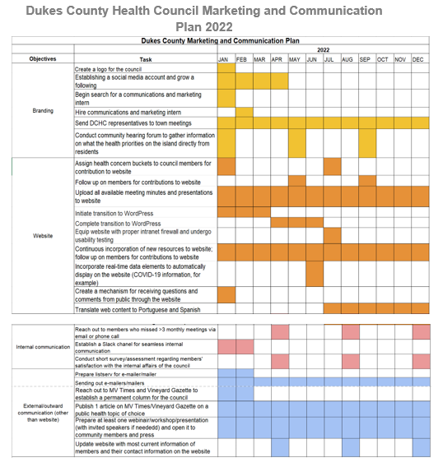

Slide 5
Newspaper Column Council members submit a brief article, 2-3 paragraphs, in their area of expertise, once every 18-24 months. Council members submit announcements, as desired, from their agencies. Content may based on National Health Awareness Days. Excerpts from DCHC minutes .

Slide 6
Resources for Success
Budget based on prior experience with similar projects will be developed and brought to the Council

